Slide 1
DIGITAL PORTFOLIO
STUDENT NAME: ABINAYA A
REGISTER NO AND NMID: asunm1397222406210
DEPARTMENT: BSC
COLLEGE: SRM ARTS AND SCIENCE COLLEGE MADRAS UNIVERSITY

Slide 2
PROJECT TITLE FROM CONCEPTS TO CODES

Slide 3


AGENDA
Problem Statement
Project Overview
End Users
Tools and Technologies
Portfolio design and Layout
Features and Functionality
Results and Screenshots
Conclusion
Github Link
3/21/2024 Annual Review

Slide 4

PROBLEM STATEMENT
In today's digital-first world, individuals often struggle to present their skills, achievements, and work experience in a centralized, accessible, and visually appealing format. Traditional resumes and paper-based portfolios are limited in scope, lack interactivity, and do not effectively showcase dynamic or multimedia content.
There is a need for a digital solution that allows users to create and manage personalized portfolios that highlight their professional and creative capabilities. This portfolio should support various content types (text, images, videos, documents, links), provide customization options, and be accessible across devices.
The absence of an engaging digital portfolio can hinder opportunities for employment, collaboration, or admission to academic programs, especially in fields where visual and project-based work is essential.

Slide 5

PROJECT OVERVIEW
A Digital Portfolio is an online platform that enables individuals to effectively present their skills, achievements, experiences, and creative work in a structured and visually engaging format. This project focuses on designing and developing a responsive and customizable web-based digital portfolio that can serve students, professionals, and creatives alike.
The portfolio will allow users to organize their content into different sections such as about Me, Resume/CV, Projects, Skills, Certificates, Gallery, and Contact Information. It will also support the integration of multimedia elements such as images, videos, PDFs, and external links to demonstrate competencies and showcase work.
This project aims to bridge the gap between traditional resumes and modern, interactive self-presentation tools, offering a more compelling way for users to stand out in academic, freelance, or job-seeking contexts.

Slide 6

WHO ARE THE END USERS? For most personal portfolios, the creator is the sole back-end user, handling all of these tasks. For more robust or team-based projects, these specialized roles ensure the portfolio remains functional, secure, and well-managed over time Content managers or editors Administrators Technical support Data analysts

Slide 7

TOOLS AND TECHNIQUES
HTML :The standard markup language for creating the structure of your website, including headings, paragraphs, and sections for projects, skills, and contact information.
CSS : Used to control the appearance and layout of your HTML elements, including colors, fonts, spacing, and animations.
JavaScript : A programming language that adds interactivity and dynamic functionality to your website, such as image sliders, form validation, or smooth scrolling effects.
Visual Studio Code : A lightweight yet powerful and highly customizable open-source editor with a vast library of extensions.

Slide 8
PORTFOLIO DESIGN AND LAYOUT
About
Skills
Education
Resume
8

Slide 9
FEATURES AND FUNCTIONALITY
Homepage/Landing Page: Introduces a professional role and value proposition.
About Me Section: A personal narrative detailing background, career goals, skills, and motivations. Include a professional photo to connect with the audience.
Projects/Work Samples Section: Showcases the best work. Each project should include a title, brief description, and the role performed.
Resume/CV: A downloadable PDF of the resume for recruiters.

Slide 10
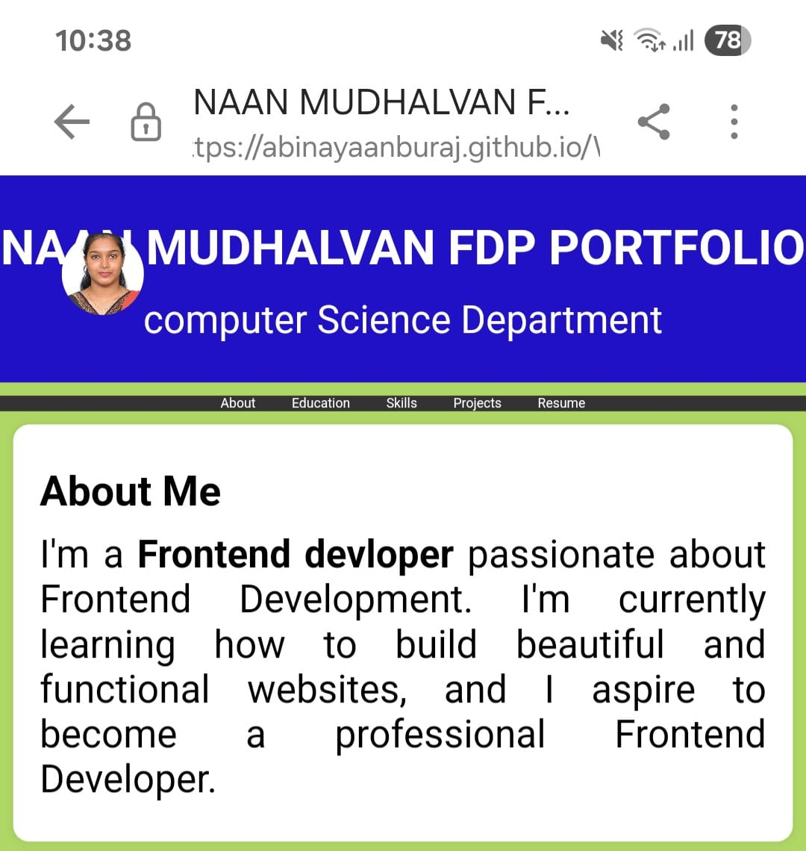

RESULTS AND SCREENSHOTS
3/21/2024 Annual Review
10

Slide 11
CONCLUSION
This digital portfolio represents the culmination of my journey through front end web development, demonstrating my growth as a student. The process of building this site with HTML, CSS, and JavaScript was a valuable exercise in not only technical development but also in critical self-reflection.
11

